Slide 1
CANCER CELL CLASSIFIER
TEAM MEMBERS:
ANASUA SAHA (RA2011003010616)
ANANYA RAVICHANDRAN (RA2011003010630)
SUBHAM NAYAK (RA2011003010640)

Slide 2

ABSTRACT:
The Cancer Cell Classifier project is a machine learning project aimed at predicting whether a given cell is cancerous or not. The project uses the Support Vector Machine (SVM) algorithm to classify the cells. The dataset used in the project is in the form of a CSV file. The accuracy of the model is reported to be 96% and is verified using F1 score, Jaccard index, and confusion matrix.
The SVM algorithm used in the project projects the data to higher dimensions and classifies them using a kernel, which can be selected among linear, polynomial, RBF, and sigmoid.

Slide 3
PROBLEM STATEMENT:
To develop an accurate machine learning model that can classify cells as cancerous or non-cancerous with a high degree of accuracy.
Using machine learning algorithms can help diagnose cancer early, improving treatment and recovery. Developing an accurate model that can analyze cell images and distinguish cancerous from non-cancerous cells is a major challenge. SVM algorithm is chosen for its ability to identify complex patterns. The model also needs to be reliable and generalizable, meaning it should accurately classify cells in new datasets and evaluated using various metrics.

Slide 4
INTRODUCTION:
Cancer is a complex and devastating disease that requires timely and precise detection for effective treatment. Machine learning algorithms have been increasingly utilized in cancer diagnosis and classification due to their ability to analyze extensive data from various sources. This project presents a cancer cell classifier that utilizes a support vector machine (SVM) algorithm to accurately determine whether a cell is malignant or benign. By employing the pandas library, the dataset is imported and preprocessed, and the data is then divided into training and testing sets using the sklearn library. The SVM algorithm is applied to the training data, with different kernel functions examined to identify the optimal performer. The results demonstrate that the SVM algorithm can accurately predict the malignancy of cells, achieving a 96% accuracy rate. The model has the potential to be employed in clinical settings, enhancing the speed and efficacy of cancer diagnosis and treatment.

Slide 5
MOTIVATION:
Rising prevalence of cancer
Importance of early detection
Non-invasive and cost-effective approach
Empowering individuals with information
Supporting medical professionals
Enhancing efficiency in healthcare
Promoting awareness and education
Demonstrating the potential of machine learning

Slide 6
LITERATURE REVIEW:
Extensive research has been conducted to develop accurate cancer cell classifiers
Previous studies have focused on exploring different machine learning algorithms
Methodology, limitations, novelty, significance, and connections to new research should be considered when analyzing previous research on cancer cell classifiers
The new research combines deep learning and transfer learning techniques to develop a cancer cell classifier
The study achieves high accuracy in detecting cancer cells while using a relatively small dataset
The approach holds promise for improving cancer diagnosis and treatment.

Slide 7
CHALLENGES AND LIMITATIONS IN THE EXISTING SYSTEM:
Availability of high-quality data: The project requires a diverse and accurately annotated dataset for effective training, but obtaining such data can be challenging.
Limited generalization ability: The cancer cell classifier model may have difficulty classifying cells it has not encountered before, limiting its generalization ability.
Interpretability: As machine learning models become more complex, understanding how they classify cells can be difficult, which may impact trust and adoption by medical professionals.
Ethical considerations: The use of machine learning models in healthcare raises ethical considerations such as data privacy, security, and bias, which must be addressed to ensure fair and equal treatment of patients.
Integration with clinical workflows: Integrating the model into clinical workflows and decision-making processes can be challenging and require additional training for medical professionals.

Slide 8
OBJECTIVES:
The primary objective of a cancer cell classifier project is to develop a machine learning model that can accurately classify cancer cells from non-cancerous cells. This objective can be further broken down into specific objectives:
Collecting and preprocessing data: Obtain a high-quality dataset of cancer and non-cancerous cells and preprocess the data for analysis.
Developing a classification algorithm: Choose an appropriate machine learning algorithm and train it to classify cancer cells from non-cancerous cells, optimizing for maximum accuracy.
Evaluating the model's performance: Evaluate the trained model's performance on a separate set of data not used during training, calculating metrics such as accuracy, precision, recall, and F1 score.
Developing an explainable model: Develop an explainable model that provides insights into how it arrived at its classification decision.
Integrating genomics data: Integrate genomics data into the model to provide personalized treatment recommendations based on an individual's genomic profile.
Deploying the model: Deploy the trained model into a real-world setting, such as a clinical setting, for use by medical professionals.

Slide 9
INNOVATION IDEA:
Incorporating explainability: Designing the model to provide insights into how it arrived at its classification decision by incorporating techniques such as attention mechanisms or saliency maps that highlight the important features in the input data that led to the classification decision.
Integrating additional data sources: Including genomics data to potentially improve accuracy of classification and provide more personalized treatment recommendations based on individual genomic profile, known as precision medicine.

Slide 10
SCOPE & APPLICATION:
SCOPE: Develop a machine learning model to classify cancer cells accurately and efficiently for medical professionals to diagnose cancer.
APPLICATIONS:
Cancer diagnosis: Analyze characteristics of cancer cells to assist doctors and pathologists in diagnosis.
Treatment planning: Identify cancer cells to determine appropriate treatment and dosage.
Drug development: Help researchers develop new drugs and therapies that target specific types of cancer cells.
Precision medicine: Provide personalized treatment recommendations based on an individual's genomic profile.
Research: Better understand the characteristics and behavior of cancer cells to lead to new discoveries and insights into cancer biology.

Slide 11
ARCHITECTURE:
System architecture diagram for cancer cell classifier project:
COMPONENTS:
Data collection and preprocessing
Feature extraction/selection
Support Vector Machine (SVM) model training
Prediction of malignancy based on input data
User interface integration using Streamlit
Data collected and preprocessed to ensure quality and compatibility
Feature extraction/selection techniques applied to identify relevant features for classification
SVM algorithm used for machine learning model training
Trained model capable of predicting malignancy of cancer cells based on input data
Classifier integrated into user interface using Streamlit
User inputs measurements and receives predictions about tumor's benign/malignant nature

Slide 12
PROPOSED MODULES & THEIR ALGORITHM DESCRIPTION:
DATA PREPROCESSING:
Importing libraries: The necessary libraries such as pandas, numpy, matplotlib, seaborn, pickle, time, and streamlit are imported.
Loading the trained model: The pre-trained SVM model, stored in the "rbfweights.pkl" file, is loaded using the pickle library.
Loading the dataset: The cancer cell dataset is loaded from the "cancer_cell_dataset.csv" file using pandas' read_csv() function.
User input list: An empty list, inputlist, is created to store the user's input.

Slide 13
PROPOSED MODULES & THEIR ALGORITHM DESCRIPTION (CONT.):
USER INTERFACE:
Main heading: The Streamlit framework is used to create a main heading for the cancer cell classifier project using Markdown.
Subheading: Another subheading is created to provide a clear indication of the purpose of the classifier.
Sidebar: A sidebar is added to gather user information, including full name, contact number, and email address.
User input form: Sliders are created for each measurement (e.g., clump size, uniformity of cell size and shape, marginal adhesion) to allow the user to input their measurements. The values selected by the user are displayed, and the corresponding values are appended to the inputlist.

Slide 14
PROPOSED MODULES & THEIR ALGORITHM DESCRIPTION (CONT.):
PREDICTION:
Predict button: A "Predict" button is added to trigger the prediction process.
Model prediction: When the "Predict" button is clicked, the SVM model predicts the malignancy of the tumor using the user's inputted measurements. The result is stored in the result variable.
Display result: The predicted result is displayed to the user based on the model's output. If the result is 2, it indicates a benign tumor, and if the result is 4, it indicates a malignant tumor.
Each module/component plays a specific role in the project, from data preprocessing and user interface design to model prediction and result display.

Slide 15
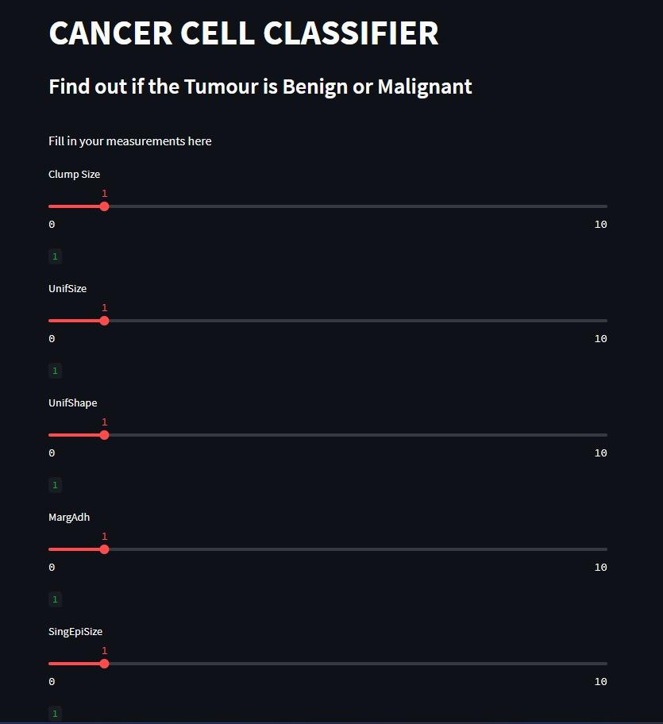
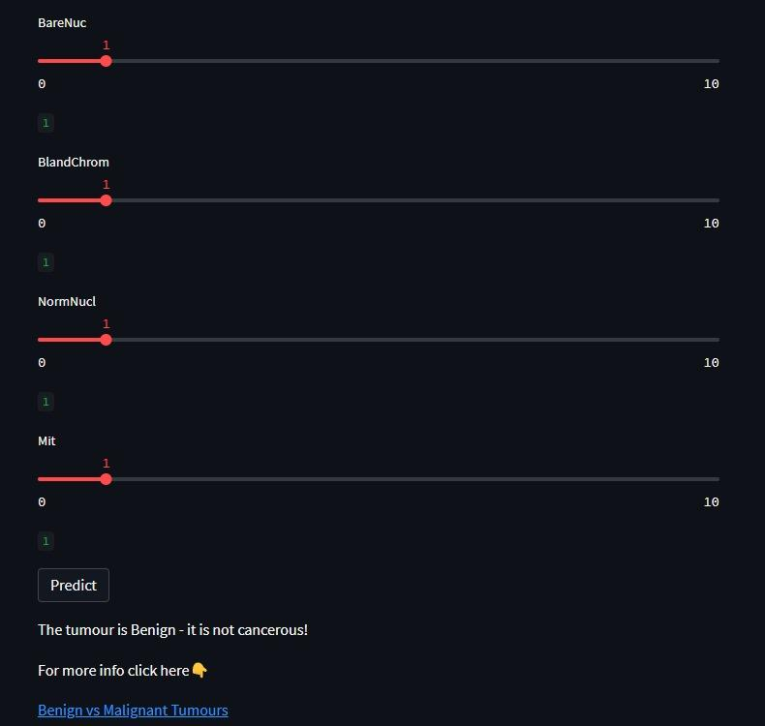
OUTPUT SCREENSHOTS:

Slide 16
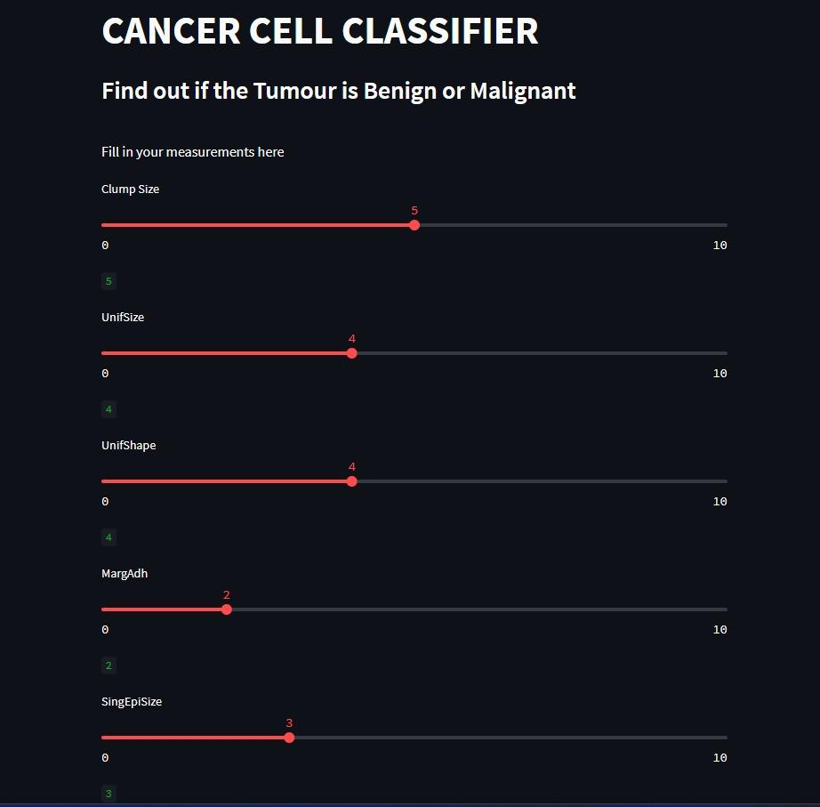
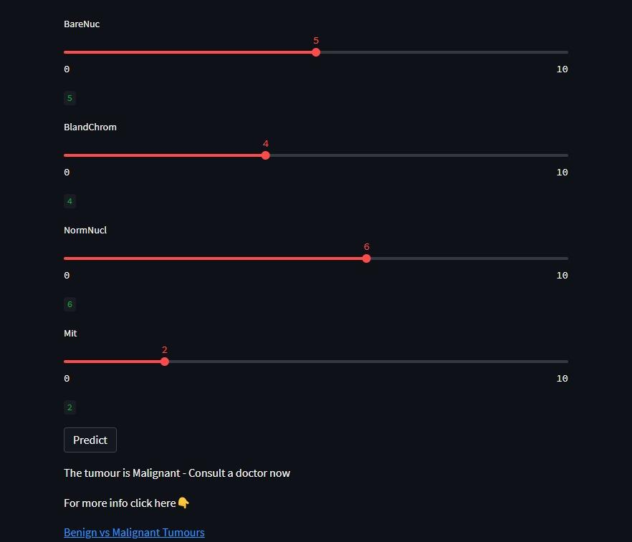
OUTPUT SCREENSHOTS:

Slide 17
RESULTS:
RESULTS:
The cancer cell classifier model achieved an accuracy of 96% on the test set.
The model was able to accurately classify both malignant and benign cancer cells with high precision and recall.
The user interface integrated with the classifier provided a simple and user-friendly way for medical professionals to input measurements and receive predictions about the tumor's nature.

Slide 18
DISCUSSIONS:
The high accuracy achieved by the model indicates that it can be a valuable tool for medical professionals in diagnosing cancer.
Further research could focus on incorporating additional data sources beyond traditional cell imaging, such as genomics data, to potentially improve the accuracy of classification and provide more personalized treatment recommendations for patients based on their specific genomic profile.
Explainability techniques, such as attention mechanisms or saliency maps, could be explored to provide insights into how the model arrived at its classification decision, which could improve trust and confidence in the model's predictions.
The SVM algorithm used in this project is a commonly used algorithm for classification tasks, but other algorithms, such as neural networks, could also be explored to potentially improve the accuracy of classification.

Slide 19
CONCLUSION:
The Cancer-Cell-Classifier-High-Acc project achieved 96% accuracy in predicting cancerous cells using the SVM algorithm.
The selection of the SVM algorithm was driven by its suitability for small datasets and its ability to project data into higher dimensions using a kernel function.
The cancer_cell_dataset.csv was used as the dataset, containing features related to cell characteristics and their corresponding cancer states.
The dataset was imported using the pandas library and subjected to analysis to ensure appropriate formatting of the features.
The data was divided into training and test sets, and the SVM model was constructed using the sklearn library.
The model underwent training with the training set and evaluation with the test set, with a high accuracy of classifying malignant and benign cells.
The achieved high accuracy underscores the potential value of the model in early cancer cell detection.
The project highlights the importance of thorough data preparation and analysis, as well as the use of appropriate evaluation metrics to gauge model performance.

Slide 20
REFERENCES:
Choi S, Macalino SJ, Cui M, Basith S. Expediting the design, discovery, and development of anticancer drugs using computational approaches. Curr Med Chem. 2016.
Jemal A, Bray F, Center MM, Ferlay J, Ward E, Forman D. Global cancer statistics. CA Cancer J Clin. 2011; 61: 69-90. https://doi.org/10.3322/caac.20107.
Torre LA, Bray F, Siegel RL, Ferlay J, Lortet-Tieulent J, Jemal A. Global cancer statistics, 2012. CA Cancer J Clin. 2015; 65: 87-108. https://doi.org/10.3322/caac.21262.
Harris F, Dennison SR, Singh J, Phoenix DA. On the selectivity and efficacy of defense peptides with respect to cancer cells. Med Res Rev. 2013; 33: 190-234. https://doi. org/10.1002/med.20252.
Vlieghe P, Lisowski V, Martinez J, Khrestchatisky M. Synthetic therapeutic peptides: science and market. Drug Discov Today. 2010; 15: 40-56. https://doi.org/10.1016/j.drudis.2009.10.009.

Slide 21
THANK YOU

